Slide 1
Data Science Exercise
NYC taxis

Slide 2
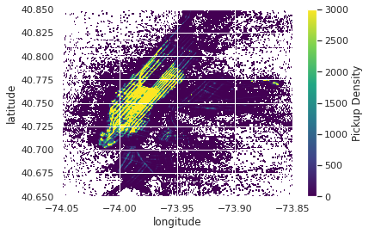
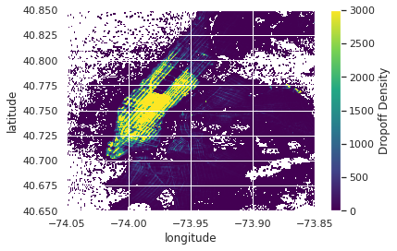
Exploratory Analysis
What are busiest locations and hours?

Slide 3
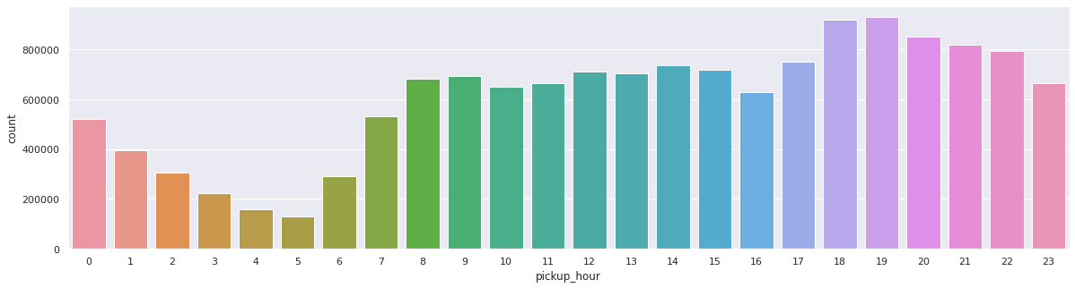
Exploratory Analysis
What are busiest locations and hours?

Slide 4
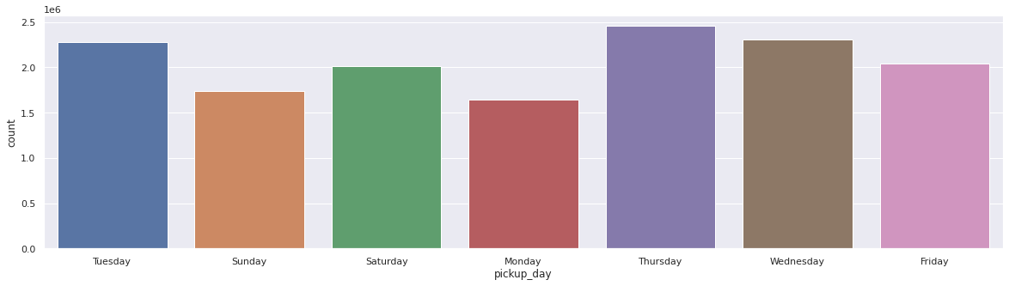
Exploratory Analysis
What are busiest locations and hours?

Slide 5
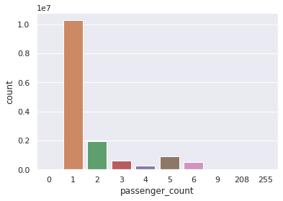
Exploratory Analysis
2. How are passengers per trip, payment type, fare and tip amounts distributed?

Slide 6
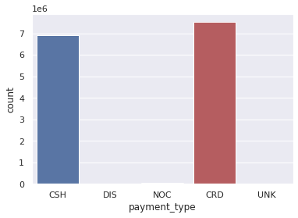
Exploratory Analysis
2. How are passengers per trip, payment type, fare and tip amounts distributed?

Slide 7
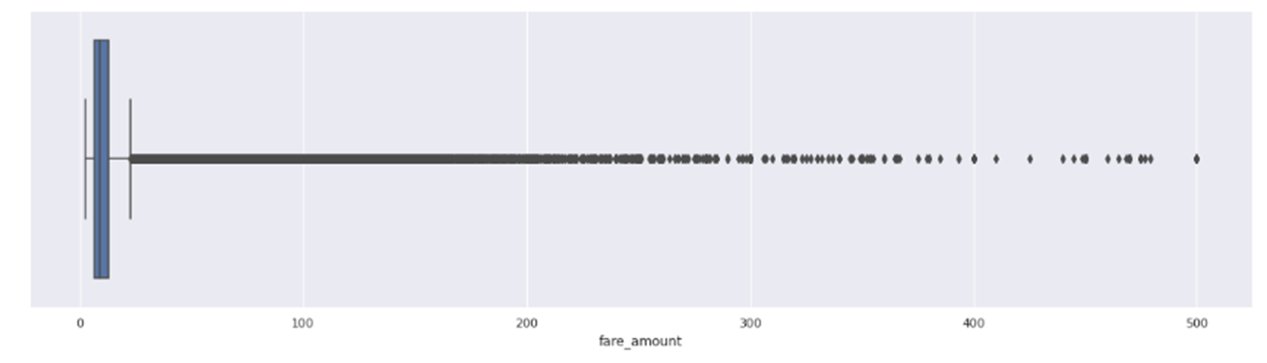
Exploratory Analysis
2. How are passengers per trip, payment type, fare and tip amounts distributed?
Box plot

Slide 8
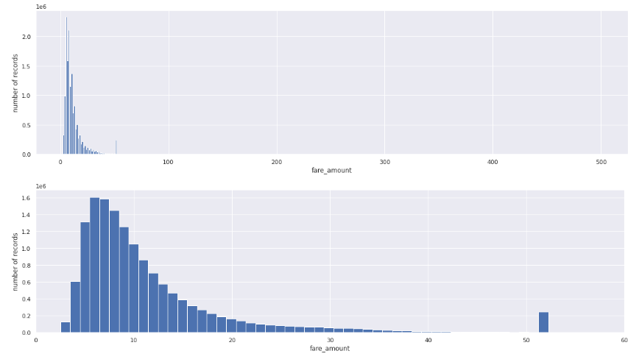
Exploratory Analysis

Slide 9
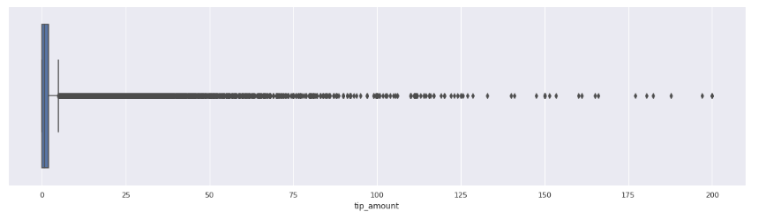
Exploratory Analysis
2. How are passengers per trip, payment type, fare and tip amounts distributed?
Box plot

Slide 10
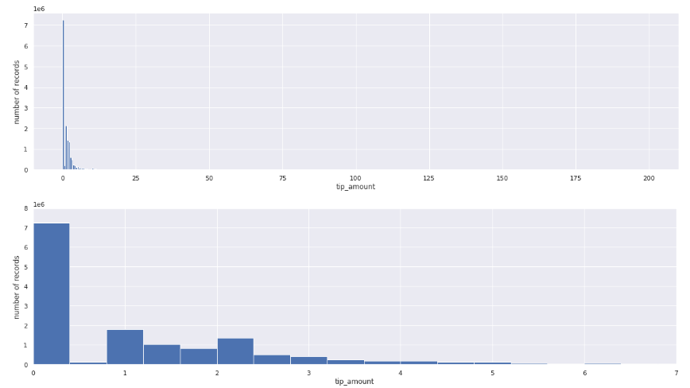
Exploratory Analysis

Slide 11
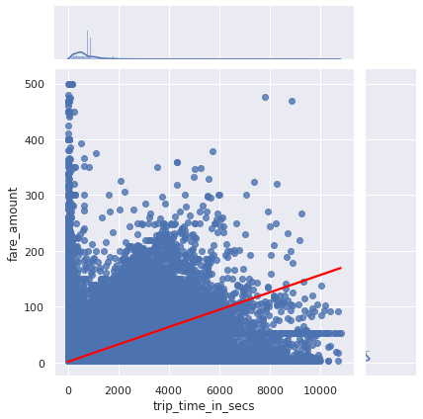
Exploratory Analysis
3. How do times and fares vary by trips?

Slide 12
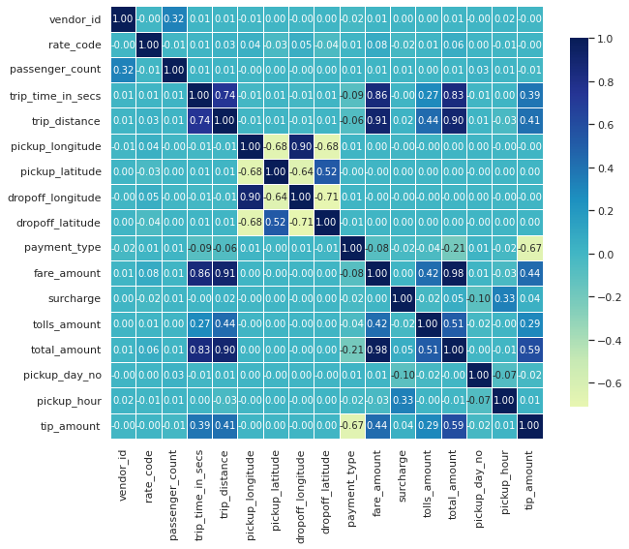
Exploratory Analysis
3. How do times and fares vary by trips?
Correlation heat map

Slide 13
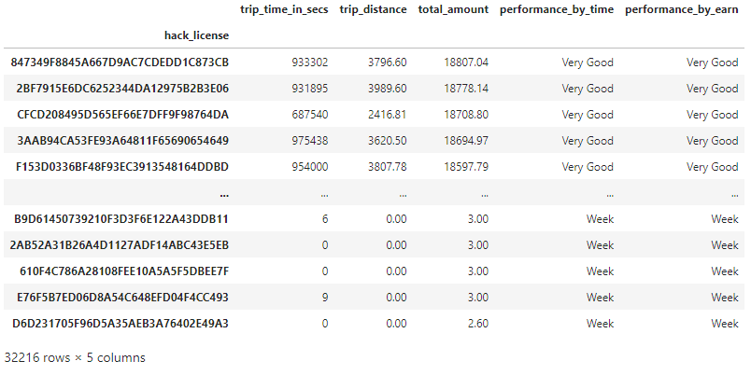
Exploratory Analysis
4. Is it possible to characterise taxi drivers based on work hours and how much they make?
This deriver drives [(933302)/(3600*31)] = 8.36 hours per day to earn $18807

Slide 14
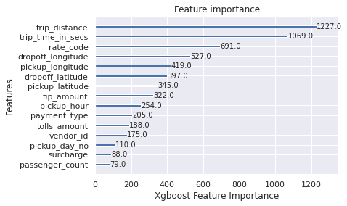
Open Questions
5. What features influence fare and tip amounts?

Slide 15
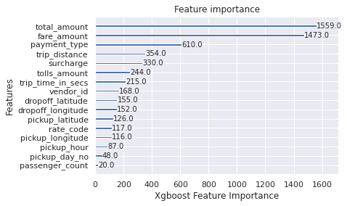
Open Questions
5. What features influence fare and tip amounts?

Slide 16
Open Questions
5. What features influence fare and tip amounts?
Correlation heat map

Slide 17
Open Questions
6. Can we build a model to predict fare and tip amount?
 | Xgboost (fare) | Light GBM (fare) | Xgboost (tip) | Light GBM (tip)
Training accuracy (%) | 0.9844 | 0.9868 | 0.9561 | 0.9890
Testing accuracy (%) | 0.9834 | 0.9864 | 0.9555 | 0.9890
RMSE (Testing) | 0.8995 | 0.8149 | 0.3341 | 0.1662
R^2 (Testing) (%) | 0.9834 | 0.9863 | 0.9554 | 0.9889

Slide 18
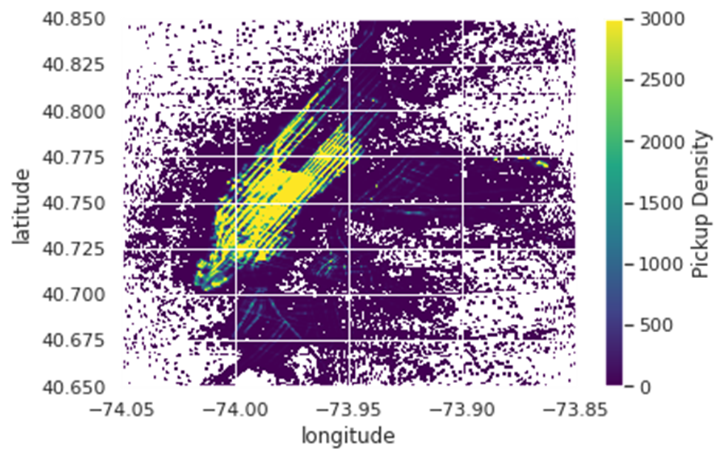
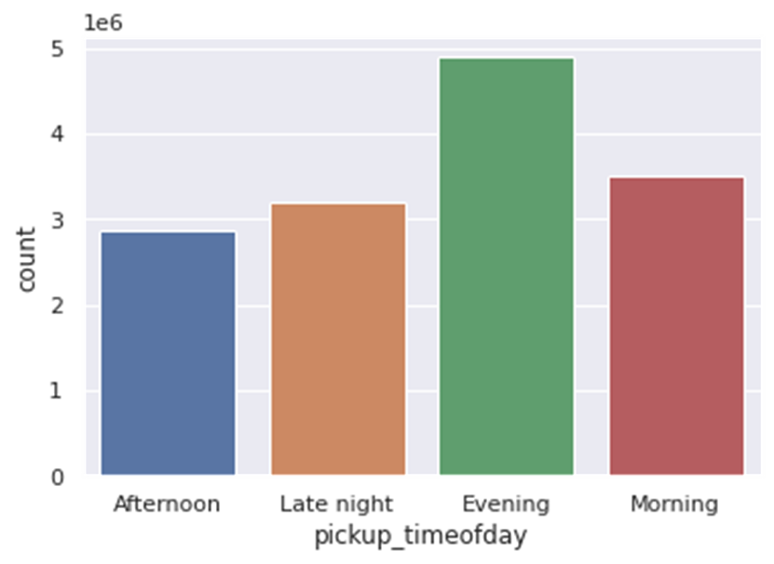
Open Questions
7. If you were a taxi owner, how would you maximize your earnings in a day?

Slide 19
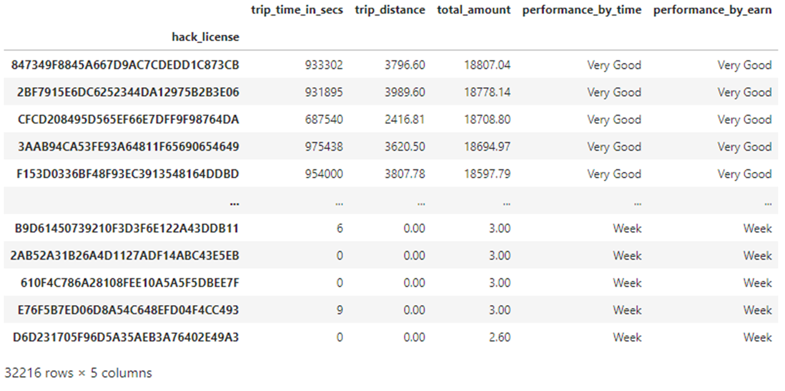
Optional Questions
8. If you run a taxi company with 10 taxis, how would you maximize your earnings?

Slide 20
Optional Questions
9. What possible issues in the data might impact your approach?
Online taxi platforms are not considered (like Uber).
Total daily work hours of taxi drivers is not recorded.
Seasonality effects have not studied yet (given the size of the data).
Public holidays have not studied.
Petrol price and different type of taxis have not considered (EV/hybrid).
Gender of drivers is not clear.

Slide 21
Optional Questions
10. What are the potential drawbacks to using the selected model? What other models might be useful?
There has been only a slight increase in accuracy by applying Light GBM over XGBOOST but there is a significant difference in the execution time for the training procedure. Light GBM is extremely faster than XGBOOST and is a much better approach when dealing with large datasets.
This turns out to be a huge advantage when working on large datasets in limited time competitions.
Light GBM uses leaf wise splitting over depth-wise splitting which enables it to converge much faster but also leads to overfitting in some cases.

